Slide 1

Al-Shaafi Diagnostics and Treatment
“and whoever saves one ; it is as if he had saved mankind entirely”
Al-Quran [05:32]
Notes:
b

Slide 2

System Administrator
USAMA SARWAR
FA17-BCS-090

Slide 3

Supervisor
Ms Azka Mehmood
Lecturer
Department of Computer Science
COMSATS University Islamabad, Sahiwal Campus

Slide 4
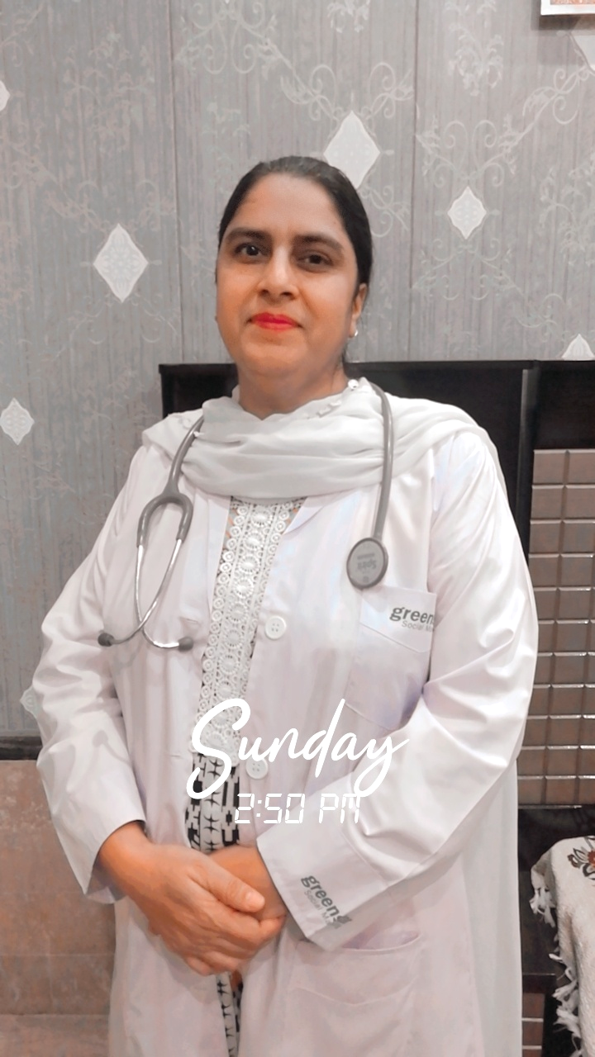




MEDICAL
DOCTORS
TEAM
Image Doctor
Image Doctor
Image Doctor
Dr. Fozia Nazir
Ob-Gynaecology Consultant
L.H.V. | D.H.M.S.
Fozia Mother Care Centre
Dr. Ata Jillani
Retired Senior Medical Officer
M.B.B.S | R.P.M.D.C
Jillani Hospital Faisalabad
Maha Akhtar
Psychologist
Faisalabad International Hospital

Slide 5
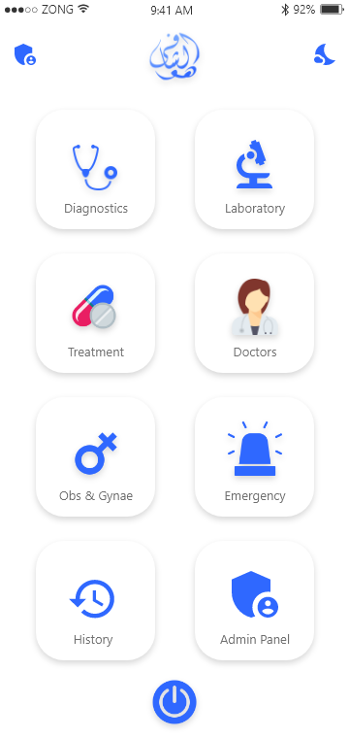
Al-Shaafi Diagnostics and Treatment
Diagnostics
Introducing digital diagnostics in which the system advises some laboratory tests against certain symptoms.
Laboratory
Laboratory declares the disease on the bases of reports of the advised medical tests.
Al-Shaafi
A System for diagnostics and treatment with Artificial Intelligence and Machine Learning
Treatment
After the identification of disease; the system recommends medicines for the proper treatment of disease.
Gynae & Obstetrics
The system guides the pregnant women throughout the nine months of their pregnancy.
Medical Consultancy
Expert doctors are available for the proper medical consultancy.

Slide 6
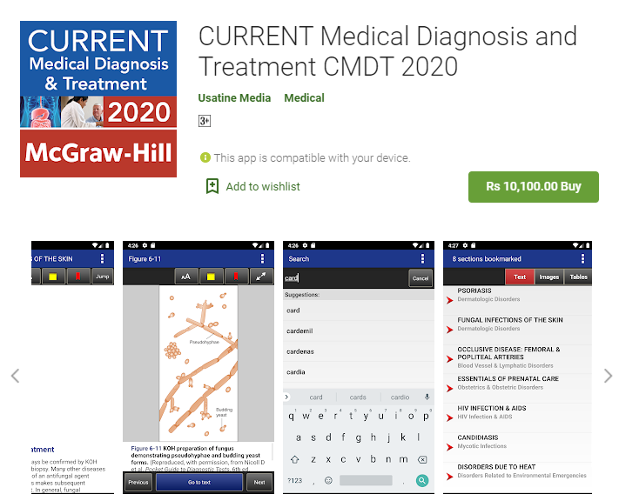
Similar App 1

Slide 7
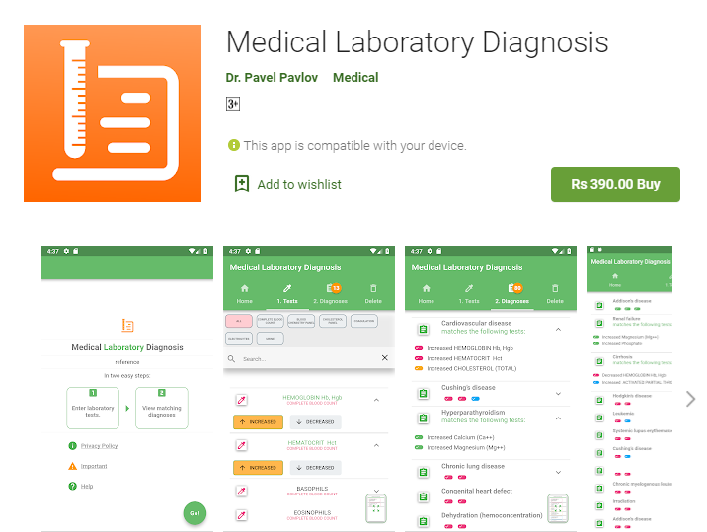
Similar App 2

Slide 8
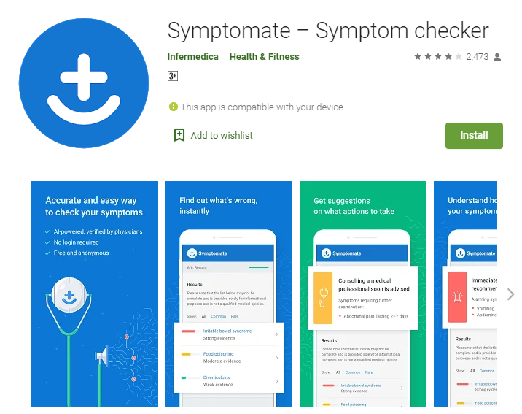
Similar App 3

Slide 9

“
Problems Faced by Doctors

Slide 10

Problem Statement 1
“
The experience of a doctor is limited to his/her life span.

Slide 11

Problem Statement 2
“
Uncatched exceptions in diagnostics and treatment.

Slide 12
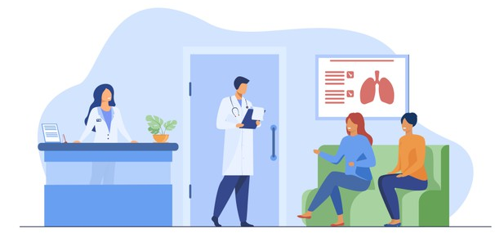
Problem Statement 3
“
Limited number of doctors can’t serve the entire nation.

Slide 13

Problem Statement 4
“
Medical checkup is not affordable for the poor.

Slide 14
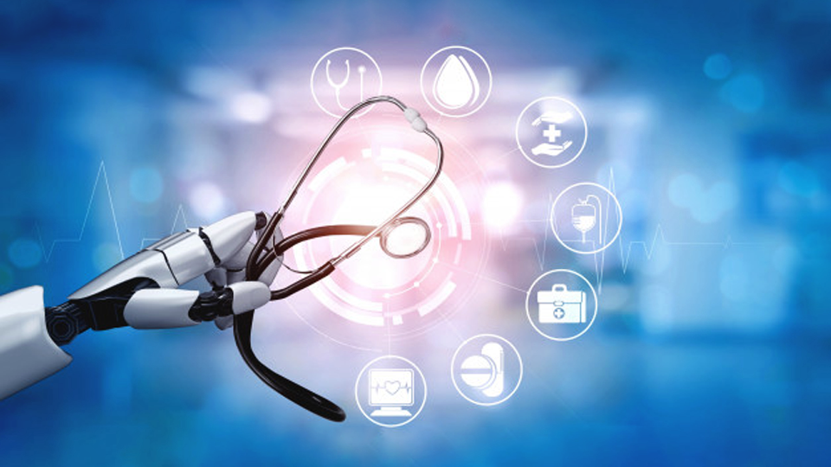
“
Problem Solution

Slide 15

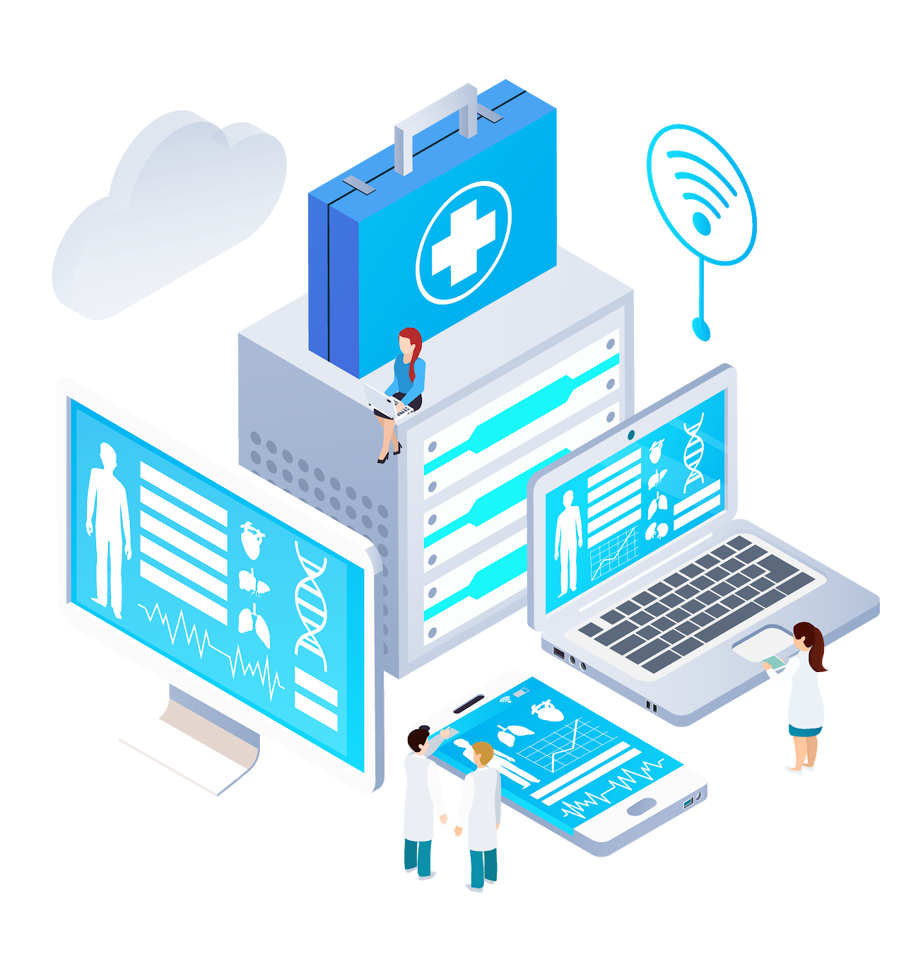
Problem Solution 1
“
The experience of a doctor is limited to his/her life span.
Preserving the experience of doctors in an expert system.

Slide 16
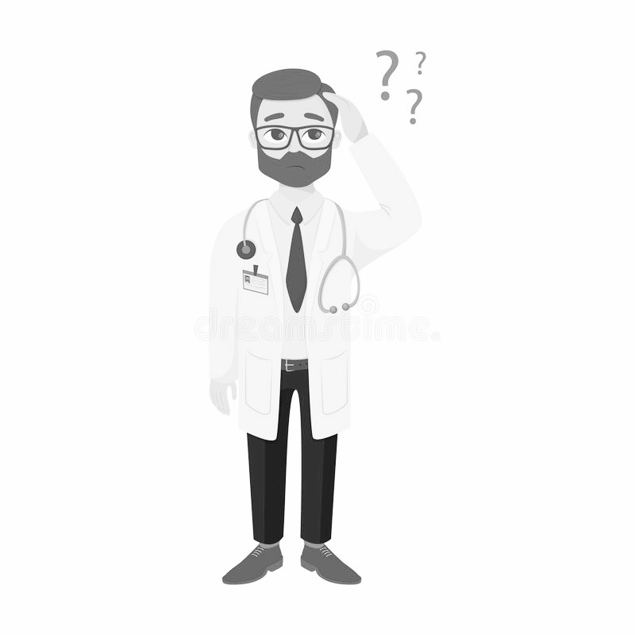
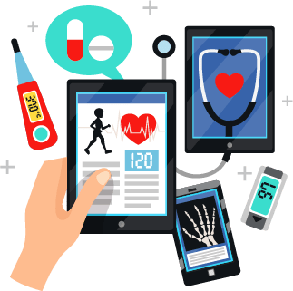
Problem Solution 2
“
Uncatched exceptions in diagnostics and treatment.
Catching exceptions using real-time results instead of results from a repository.

Slide 17
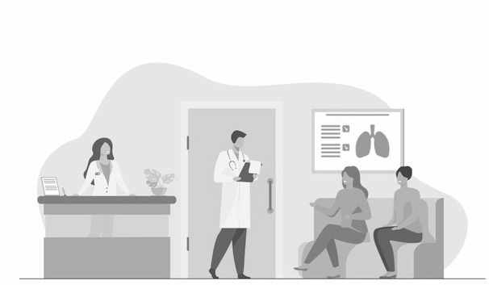
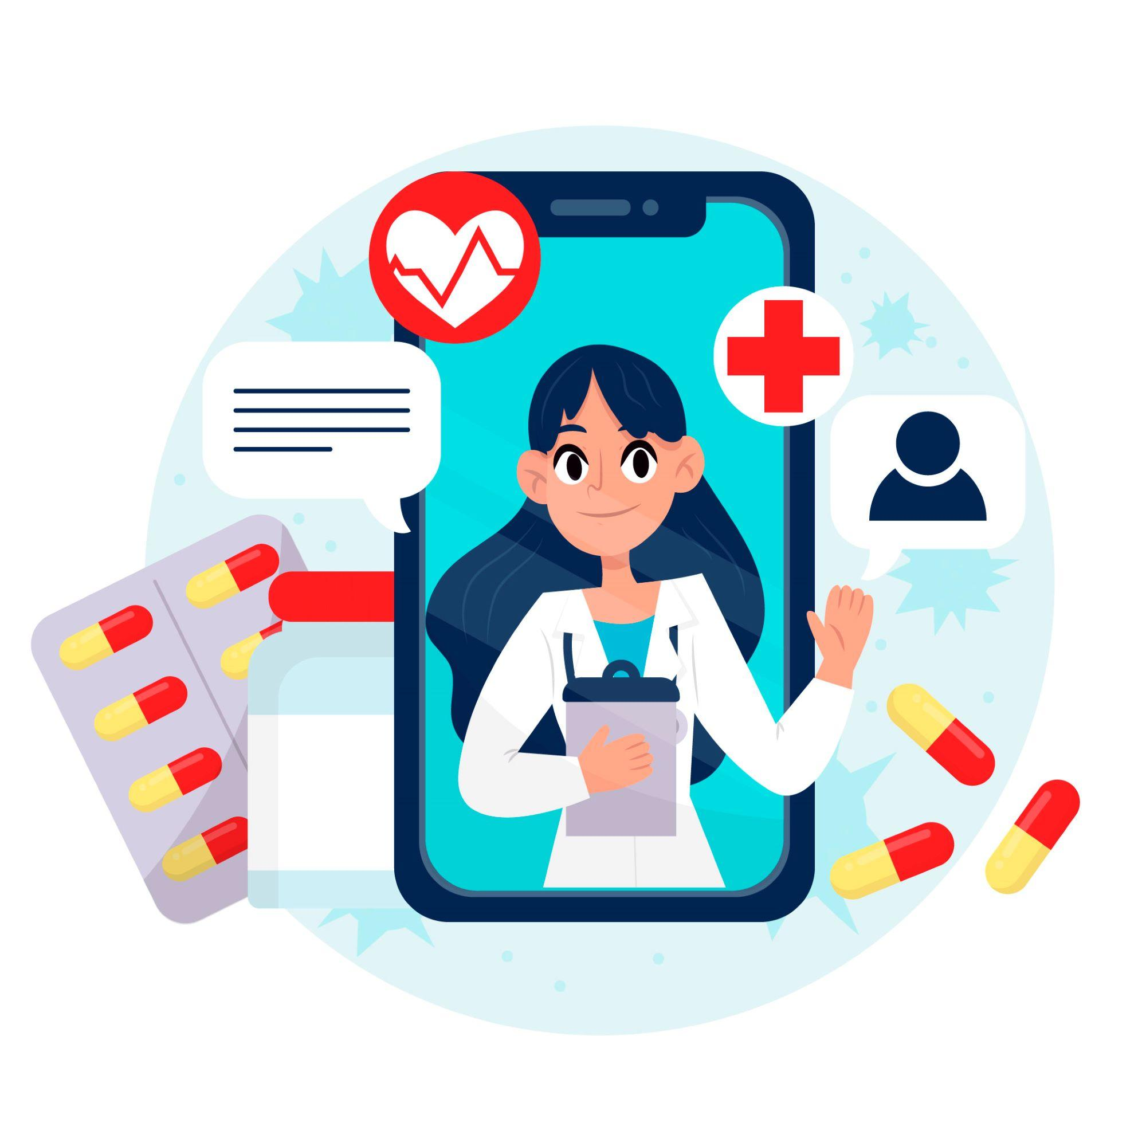
Problem Solution 3
“
Limited number of doctors can’t serve the entire nation.
An expert system serving multiple clients at once.

Slide 18
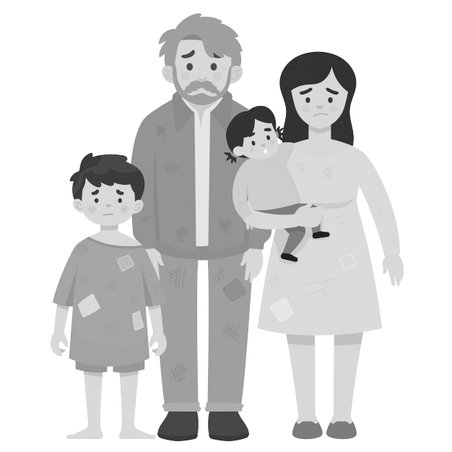
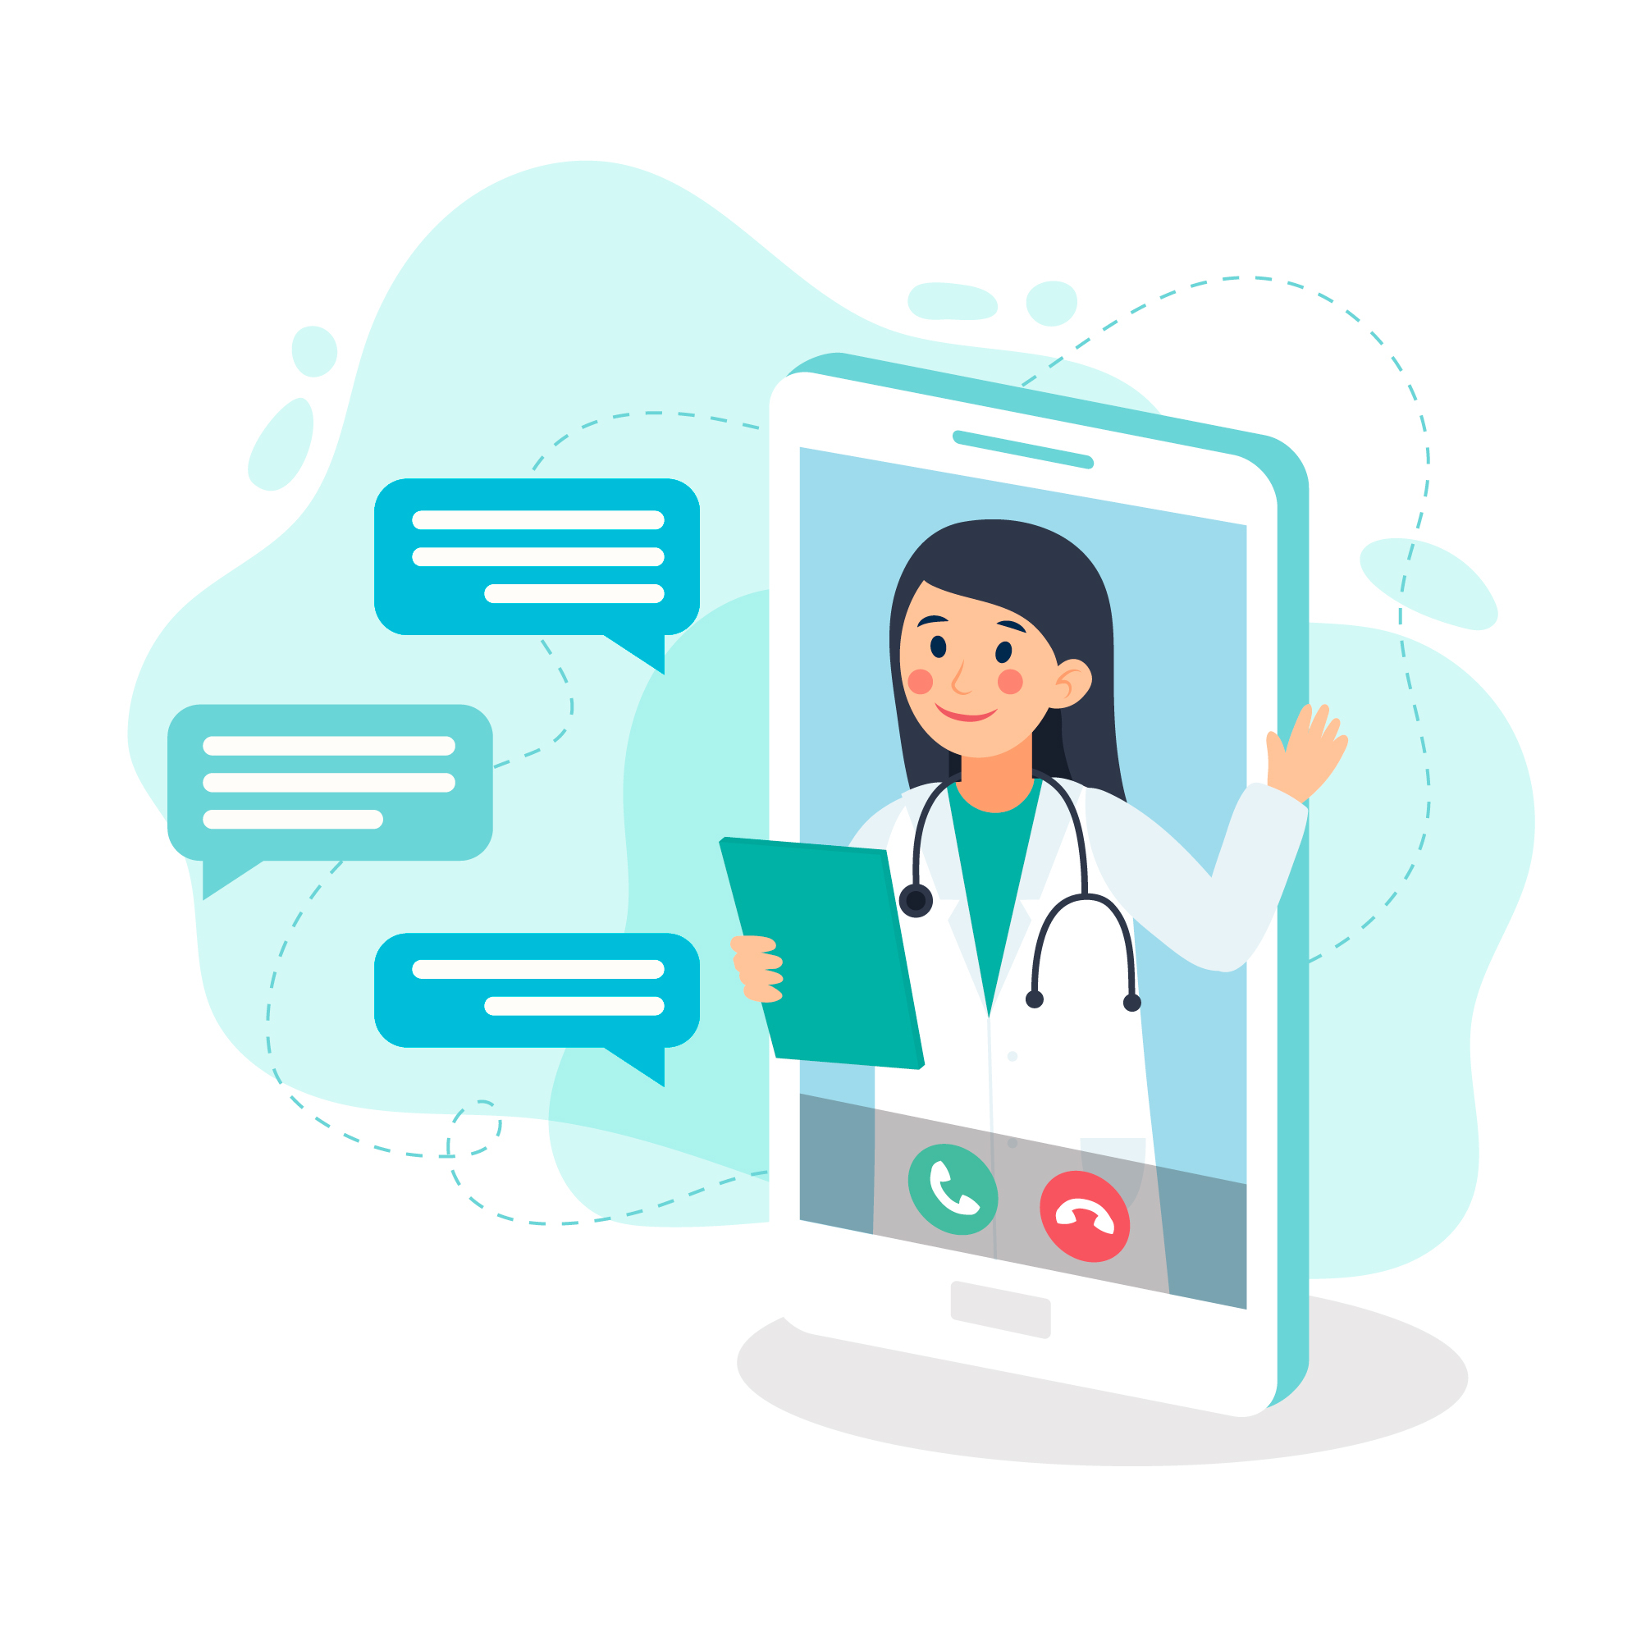
Problem Solution 4
“
Medical checkup is not affordable for the poor.
Reducing medical check up fee to almost free with the help of Artificial Intelligence.

Slide 19

Artificial Intelligence
Machine
Learning

Slide 20
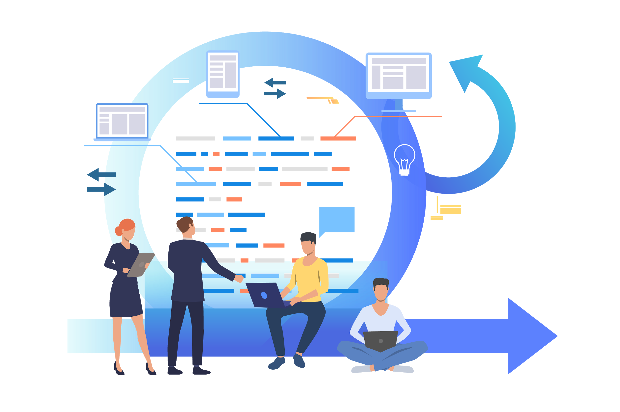
Functional Requirements

Slide 21

#1
Physical Examination
Notes:
Physical Examination:
In a physical examination, medical examination, or clinical examination, a medical practitioner examines a patient for any possible medical signs or symptoms of a medical condition.

Slide 22
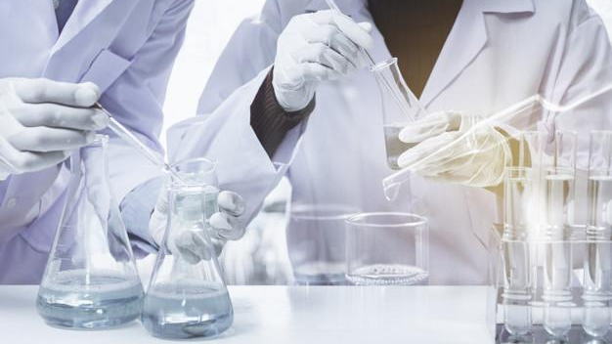
#2
Laboratory Test(s) Prediction (Artificial Intelligence)
Notes:
The system would intelligently predict laboratory test(s) based on physical examination to make sure about the disease of victim.

Slide 23

#3
Disease Declaration Based on Laboratory Report(s)
Notes:
Laboratory Report would declare the disease to the Victim.

Slide 24

#4
Treatment/Cure
Notes:
Medicine Recommendation based on previous positive feedbacks of the same kind of victims.

Slide 25

#5
Obstetrics and Gynae (OB/GYN)
Notes:
Obstetrics (the OB) involves care during pre-conception, pregnancy, childbirth, and immediately after delivery.
Gynecology (the GYN) involves care of all women's health issues.

Slide 26
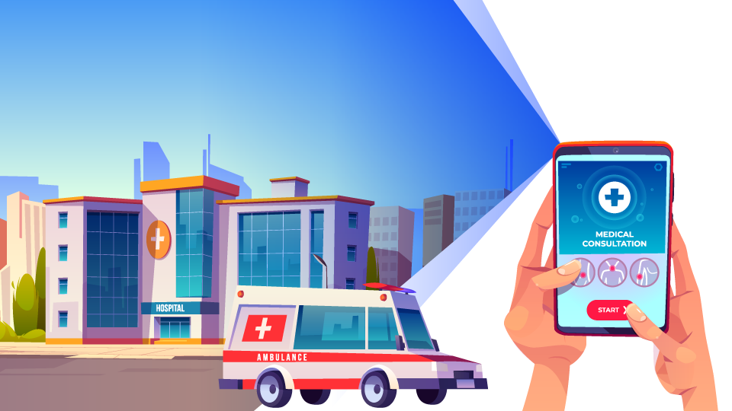
#6
Medical Consultancy
Emergency Services (24/7)
Notes:
Emergency Services 24/7

Slide 27

#7
Patient Medical History (Storing & Retrieving on CNIC Card)
Notes:
Storing/Retrieving Patient’s medical history by scanning the CINC Card of patient

Slide 28
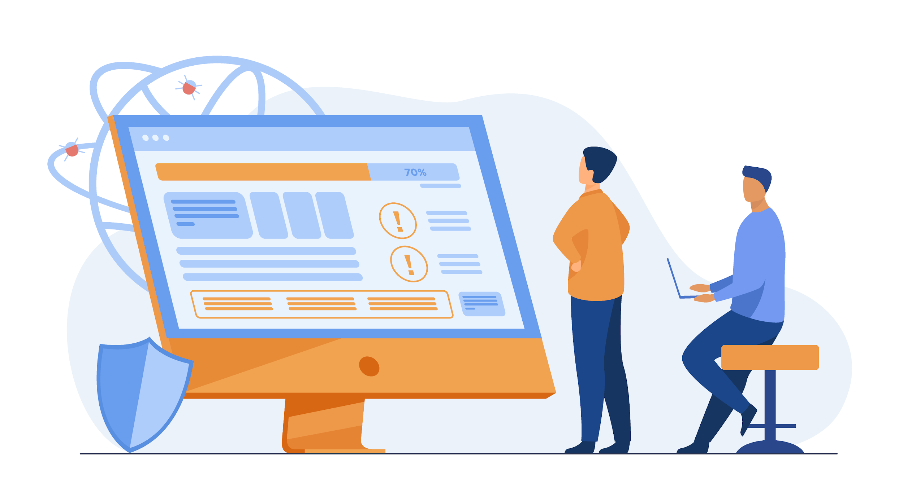
Non Functional Requirements

Slide 29
#1
Reliability
#2
Usability
#3
Cross-Platform
#4
Security
#5
Performance
#6
Portability

Slide 30


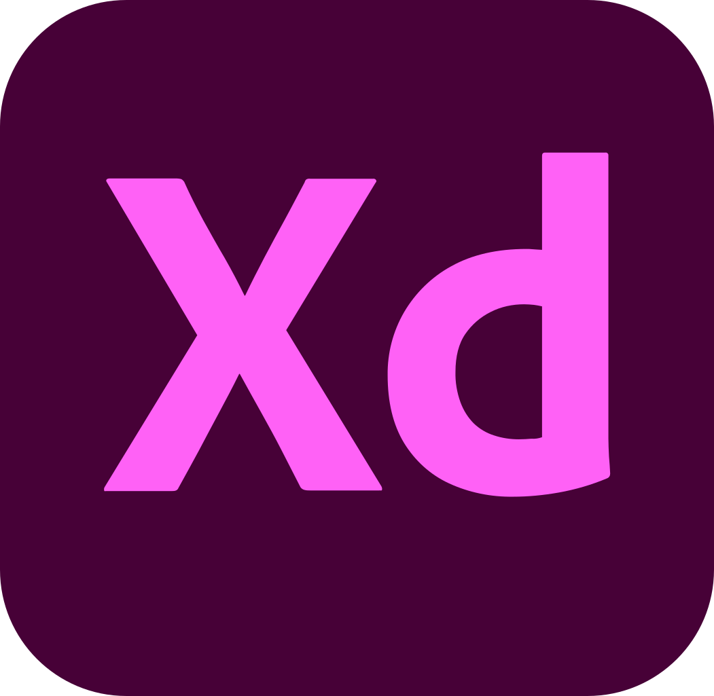









Tools & Technologies

Slide 31

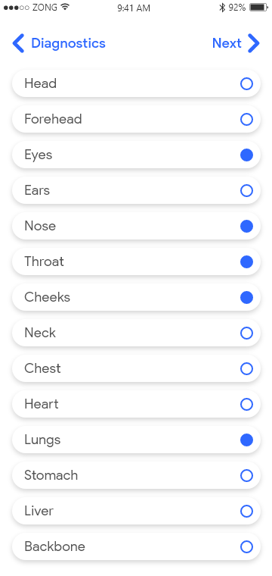
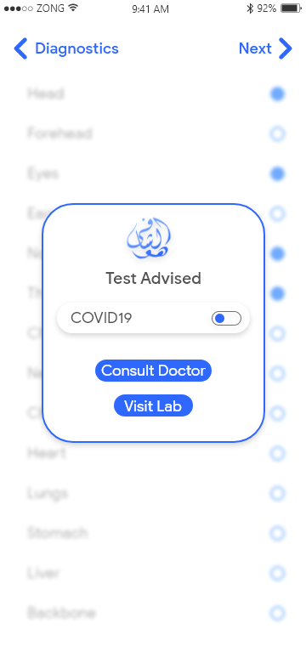
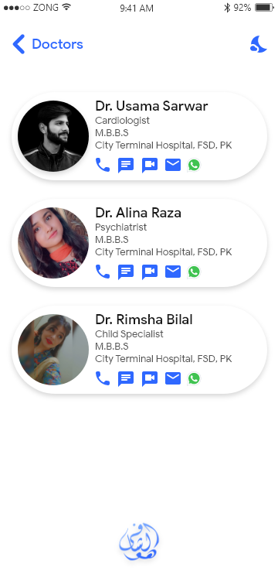
Mockups

Slide 32
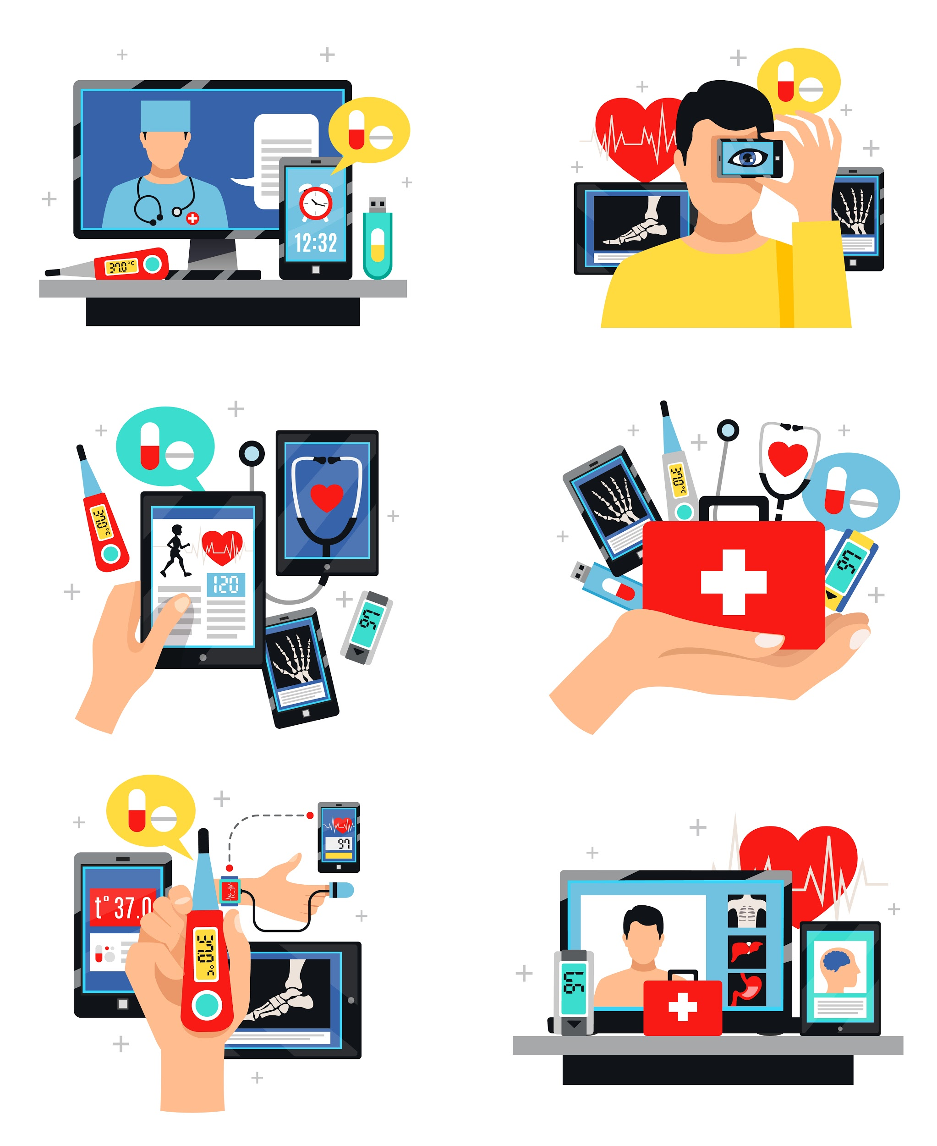
Conclusion
Diagnosis
Laboratory
Treatment
History
Cost Efficient
Consultancy

Slide 33
References
CURRENT Medical Diagnosis and Treatment CMDT 2020
(https://play.google.com/store/apps/details?id=com.usatineMediaLLC.cmdt2020)
Medical Laboratory Diagnosis
(https://play.google.com/store/apps/details?id=com.toolcoder.medicallaboratorydiagnosis)
Symptomate – Symptom checker
(https://play.google.com/store/apps/details?id=com.symptomate.mobile)
Mockups (Adobe XD)
(https://xd.adobe.com/view/0072b651-aec0-4404-8a52-24ecec2ae6d3-5521/?fullscreen&hints=on)

Slide 34


